Slide 1
MAR 530: Ecosystem Based Fisheries Management
Acknowledgements:
Sarah Gaichas, Jason Link, Jon Hare, Michael Fogarty, Geret DePiper, Sean Lucey, Scott Large, Ian Mitchell, Mark Dickey-Collas, Anna Rindorf
Lecture 6
Ecosystem Indicators
www.mycourses.umassd.edu
06 March 2015

Slide 2
Today’s Outline
Ecosystem Indicators
Indicator Taxonomies & Properties
Presenting Indicators
Using Indicators
Discussion on:
Hall and Mainprize 2004
Halpern et al. 2012
Jennings 2005
Link 2005

Slide 3
One Main Theme Throughout Course
CONFRONTING TRADEOFFS

Slide 4
Simplified Schedule
Week | Theme | Topic
1/30 | Context | Introduction, What is EBFM?
2/6 |  | Challenges facing fisheries, what can EBFM offer?
2/13 |  | Guest lecture: case studies of EBFM
2/20 |  | Types of advice, decision theories, goal-setting
2/27 | Operational | Bycatch, habitat, and spatial management
3/6 |  | Ecosystem indicators
3/13 |  | Extended single-species and multispecies models
3/20 |  | SPRING BREAK
3/27 |  | Aggregate and system models
4/3 |  | Ecological risk assessment
4/10 | Institutional | Societal and economic considerations
4/17 |  | Governance and management institutions
4/24 | Holistic | Evaluating tradeoffs
5/1 |  | Moving towards ecosystem based management
5/8 |  | Final exam: Project Presentations

Slide 5



Link’s Three Pillars
1. Goal Setting (Priorities & Allocation of Biomass)
2. Assessing [Ecosystem] Status (Multivariate metrics)
3. Achieving [Ecosystem] Goals (Management Tools)

Slide 6
Ecosystem Indicators

Slide 7
in·di·ca·tor ( n d -k t r)n.
One that indicates, especially:
a. A pointer or an index.
b. An instrument used to monitor the operation or condition of an engine, furnace, electrical network, reservoir, or other physical system; a meter or gauge.
c. The needle, dial, or other registering device on such an instrument.
2. Chemistry: Any of various substances, such as litmus or phenolphthalein, that indicate the presence, absence, or concentration of another substance or the degree of reaction between two or more substances by means of a characteristic change, especially in color.
3. Ecology: A plant or animal whose existence in an area is strongly indicative of specific environmental conditions.
4. Any of various statistical values that together provide an indication of the condition or direction of the economy.

Slide 8

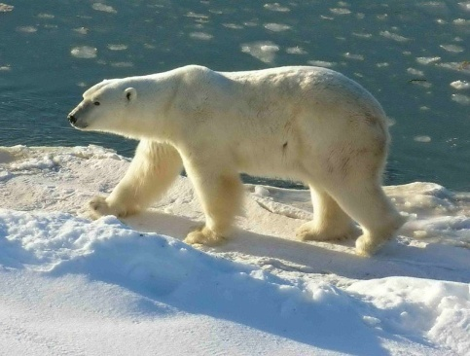


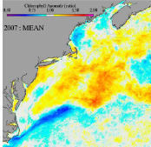

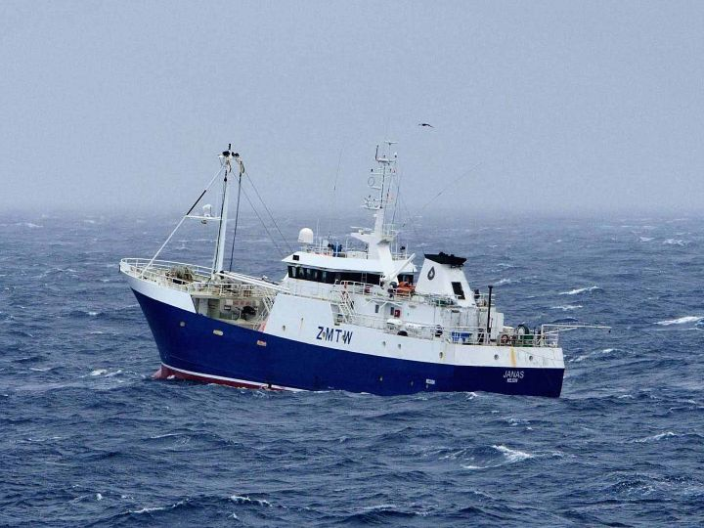

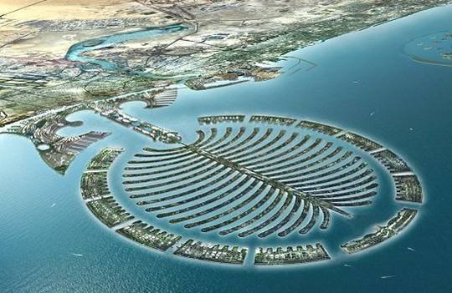
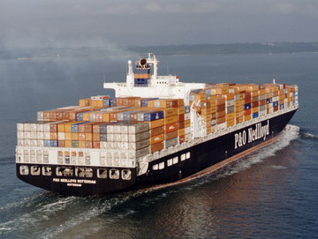

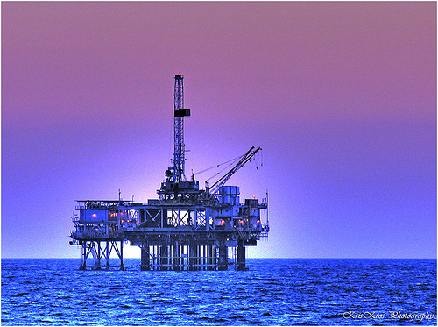

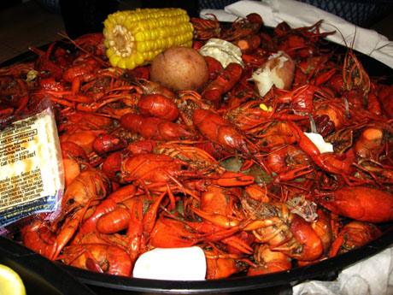



Notes:
Implications of adopting an ecosystem approach to management
This information reflects multiple, and possibly conflicting marine resource management objectives

Slide 9
Indicators as tools for Ecosystem Based Fisheries Management
Indicators provide multidisciplinary perspective on ecosystem condition. Many suggested.
Threshold values may reveal system change
Challenge: Translate responses of indicators to system pressures into management advice.
Notes:
Ecosystem indicators offer a means of synthezizing large amount of varying information on ecosystem status.
Large number of indicators proposed.
A suite of indicators usually recommended to meet multiple objective needs.
Can Changes in indicators be translated into control rules that can be used to step towards EBFM?
Focus of this work is developing and simulation testing indicator-based fishery control rules.
Tools: Simulation frameworks utilizing existing ecosystem models.

Slide 10

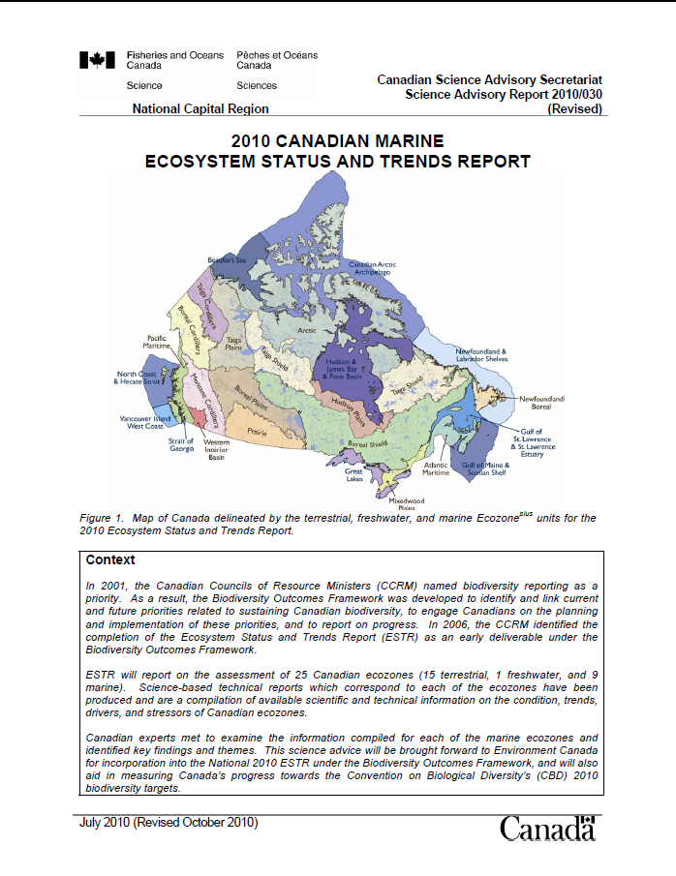
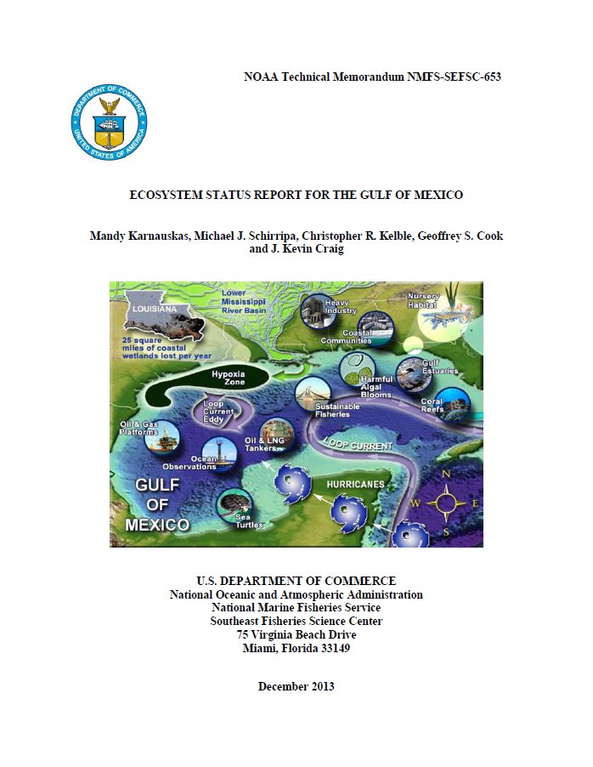
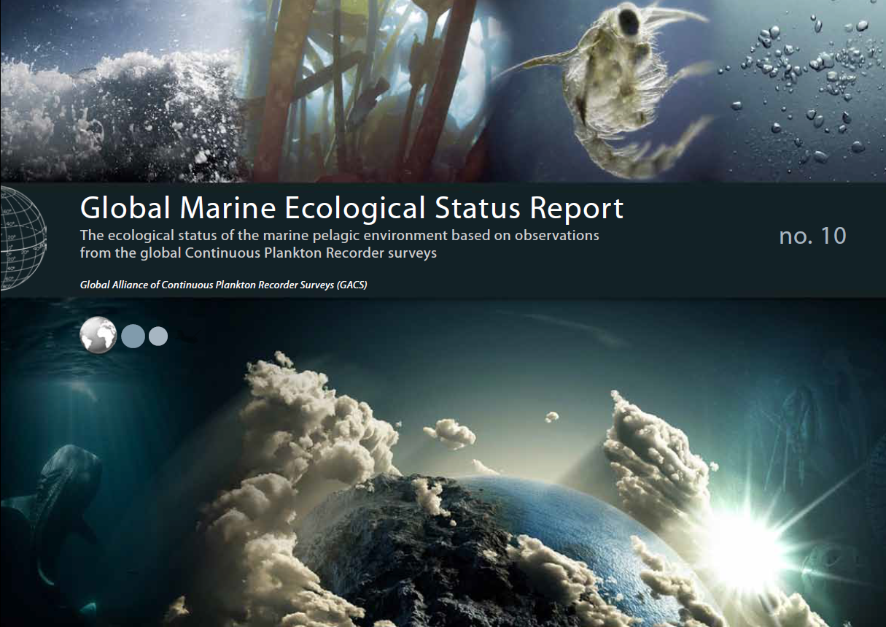

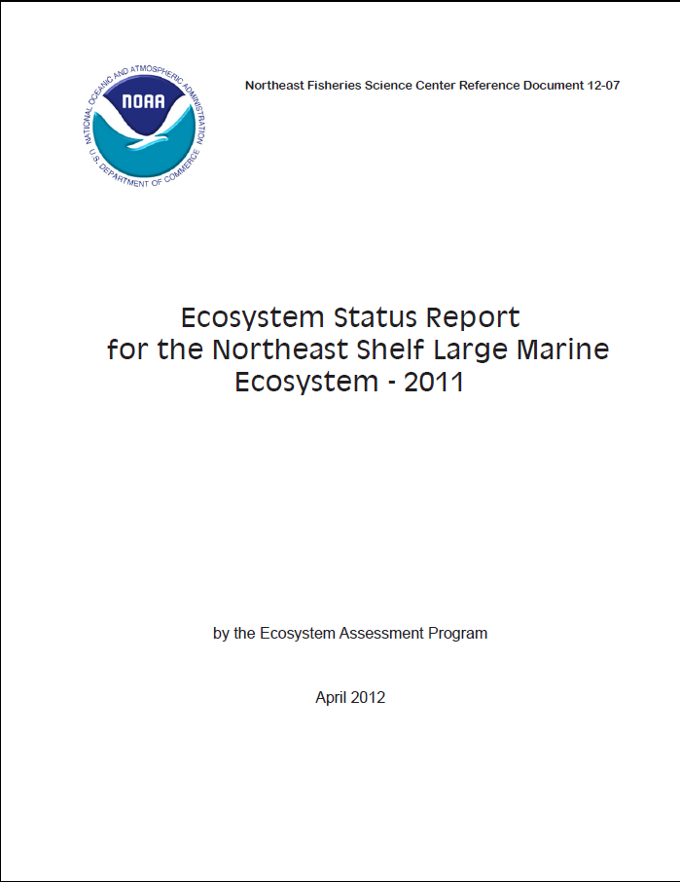

Many ecosystem indicators documents
http://www.nefsc.noaa.gov/publications/crd/crd1207/crd1207.pdf
Notes:
Stock assessments conducted annually for quota setting
Ecosystem considerations appendix to Stock Assessment and Fishery Evaluation documents since 1995
Ecosystem considerations in single species stock assessments since mid-2000s
Ecosystem assessment since 2005

Slide 11
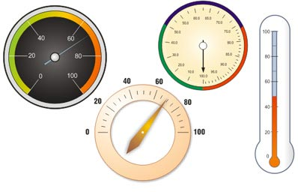
EBFM Framework
Set Goals
Assess Status
Define Decision Criteria
Ecosystem Indicators

Slide 12
Indicator Taxonomies
Indicators have had several “taxonomies”, e.g.,
Pressure (Dose, Stressor)-State-Response
Heuristic-Strategic-Tactical
Conceptual-Strategic-Operational Objectives
System-Response-Performance
Loosely group into:
Status indicators
Management indicators
Key point: They are used at all steps in an Ecosystem Based Management process.

Slide 13
Ecosystem indicators: Status
Assess historical ecosystem trends and influences
Species-specific and Systemic indicators
What is the recent history?
Determine status of present ecosystem state
Where are we relative to where we want to be?
Provide forecasts for future ecosystem attributes
In short-, medium-, and long-term
What are the effects of trends/variations in abiotic factors?
What are the effects on other biota?

Slide 14
Ecosystem indicators: Management
Set thresholds and limits
What do we know that is precautionary?
If not able to pick what ecosystem state is desirable, at least what states do we want to avoid?
Evaluate performance of past management actions
Are we where we want to be?
Invoke control rules
What actions need to be taken to achieve objectives?
What are the effects of alternative policy choices?

Slide 15
Indicators: Which ones and how many?
At least initially, Status Indicators should be as inclusive as possible (germane processes).
Indicators must span full range of appropriate biological, physio-chemical, and socio-economic factors.
The global experience is that a long “laundry list” of indicators is not immediately helpful for EBFM.

Slide 16
Vetting Indicators
Desirable Properties of Indicators:
Directional
Sensitive to change
Range spans natural variability
Precision and variance estimable & reasonable
Unambiguous
Not duplicative nor repetitive
Expressive/representative of key processes

Slide 17

Culling Indicators
Indicators should map to key processes in ecosystems.
Indicators need to map to stated (or unstated but legislatively mandated) objectives and criteria.
Broad stakeholder involvement in selecting and identifying indicators assists their use and acceptance later on in the management process.
General protocols exist for the selection of desirable indicators for EBFM.
Brian Howell ©

Slide 18
Usual Categories/Classes of EBFM indicators
Biological:
Size
Production
Diversity
“Canary” species
Physical:
Habitat
Physio-chemical regime
Socio-economic:
Fisheries capacity
Management Performance – Response

Slide 19
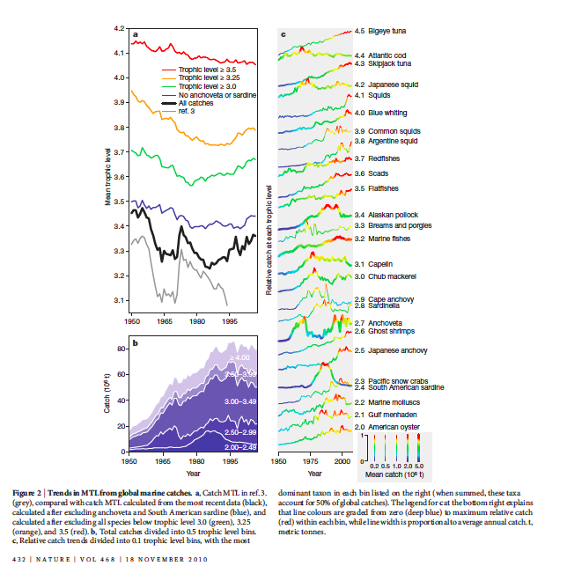
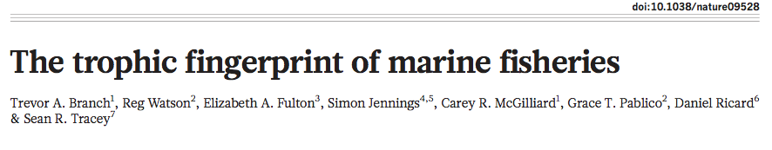
A common foodweb structure indicator:
Mean Trophic Level
(Mean Trophic Index)
Has received much attention.
e.g., fishing down/through the foodweb.
Work of Branch and others suggests caution when interpreting this indicator.

Slide 20
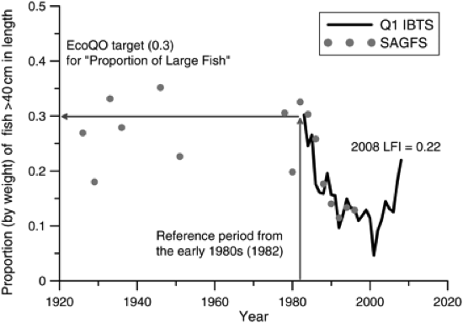
Europe: Large Fish Indicator
Variation in the redefined proportion of LFI for the North Sea demersal fish community. (Greenstreet et al., 2011)

Slide 21
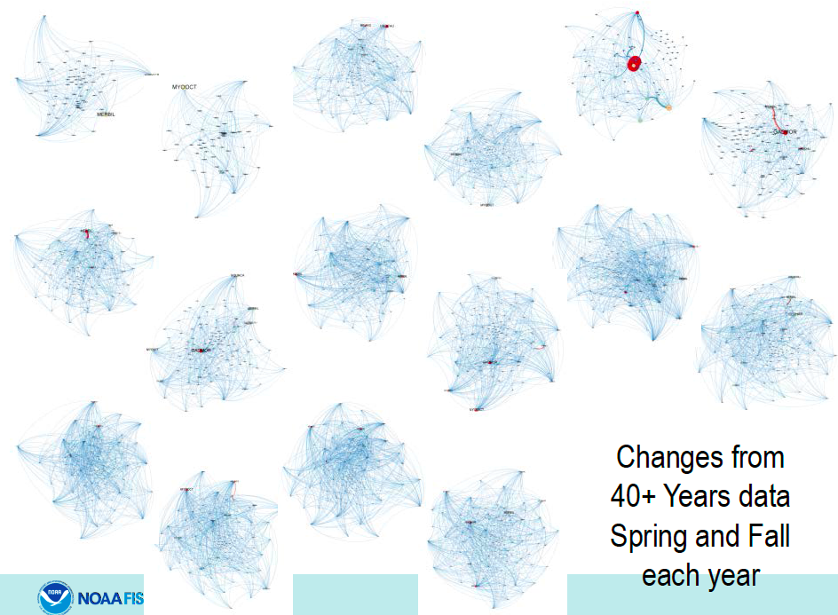
Network metrics are being increasingly used.
ge

Slide 22
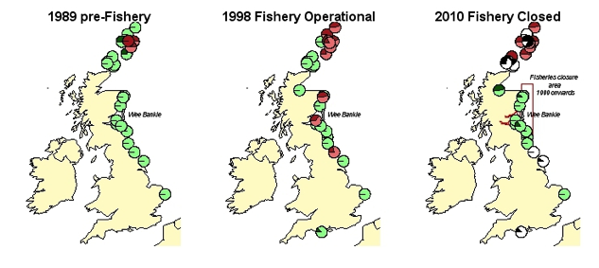
Foodweb function indicator example: Kittiwake breeding success in the North Sea
Change in kittiwake breeding success indicator in relation to the presence of the Wee Bankie sandeel fishery.
Each pie chart represents a kittiwake breeding colony, green indicates that breeding success reflected the underlying environmental conditions in the target year, red indicates that breeding success was lower than expected given the underlying environmental.
Cook et al. (2014) Ecological Indicators 38: 1–11.

Slide 23
Function indicator example: Eastern Baltic cod weight-at-age
Decline might be a consequence of several factors, including density-dependent effects, food availability, anoxic areas and parasites.
Dashed horizontal lines show the potential boundaries of GES of an assessment of age 8+ made 6 years before the most recent data point
ICES WGBFAS 2014 (Table 2.4.13).

Slide 24
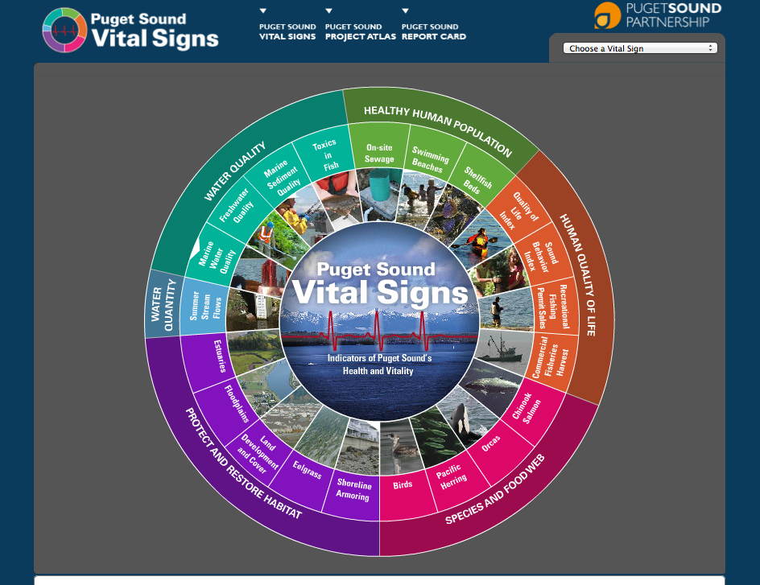
Indicators can be developed through stakeholder participation processes.
http://www.psp.wa.gov/vitalsigns/index.php

Slide 25
Presenting Indicators

Slide 26
Traffic light-consumer report approaches Based upon empirical distributions
Metric 1
Metric 2
Metric 3
Etc.

Slide 28
Summary: Traffic Light Approach
No one buys a toaster or automobile that has consistent and multiple orange or red ratings.
Similarly, fisheries managers and stakeholders would like a greener overall system status.
In redder conditions, caution is heightened.
Choose situations to make the overall status of the system greener (Fuzzy logic models).
Assumes mechanisms and specific processes to obtain green conditions are known and can be manipulated.
Although qualitative, feasible for most agencies to at least use in assessing system-level status.

Slide 29
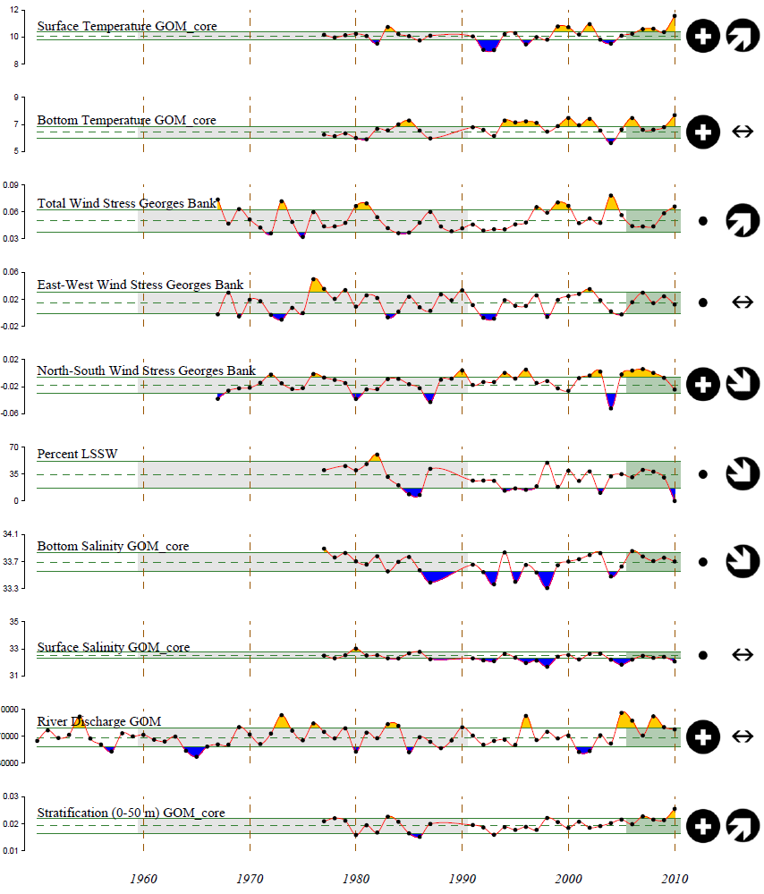
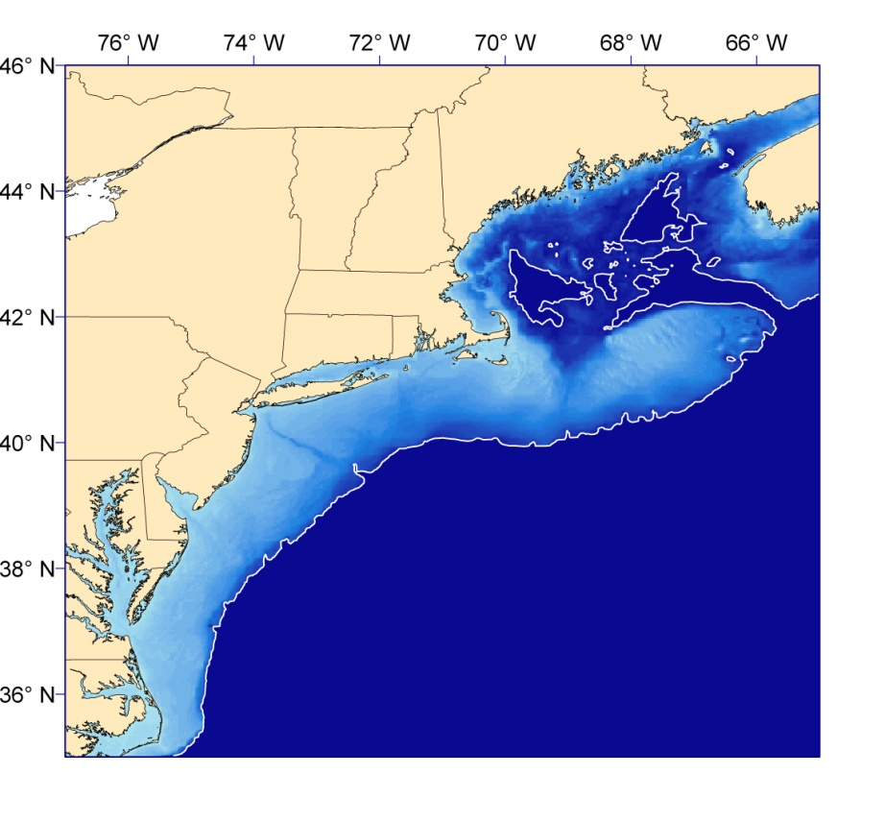
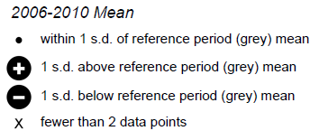
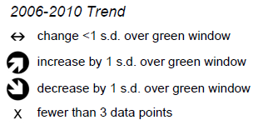
Gulf of
Maine
Sarah Gaichas, NOAA NEFSC
Notes:
We have lots of indicators – many more than this to summarize over…..

Slide 30
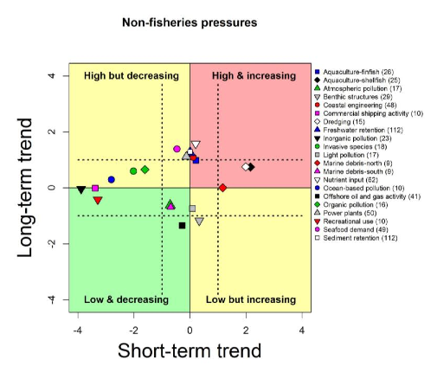
Summarize multiple indicators according to short and long-term trends.
CCIEA
Notes:
Summarize across indicators by plotting summary statistics in kobe plot.
Not sure whether to mention synthetic indicators (e.g. OHI, etc.)

Slide 31
Polar plots, reference surfaces, Amoebas
Surface plots allow the simultaneous evaluation of 3 to 4 dimensions. Often used to show concurrent minima or maxima.
Polar plots (compass/spider plots) allow the simultaneous evaluation of multiple indicators.
Both can be either model or empirically based.
Pro: evaluation of multiple indicators simultaneously.
Con: limited to a subset of indicators, not necessarily integrative.

Slide 32
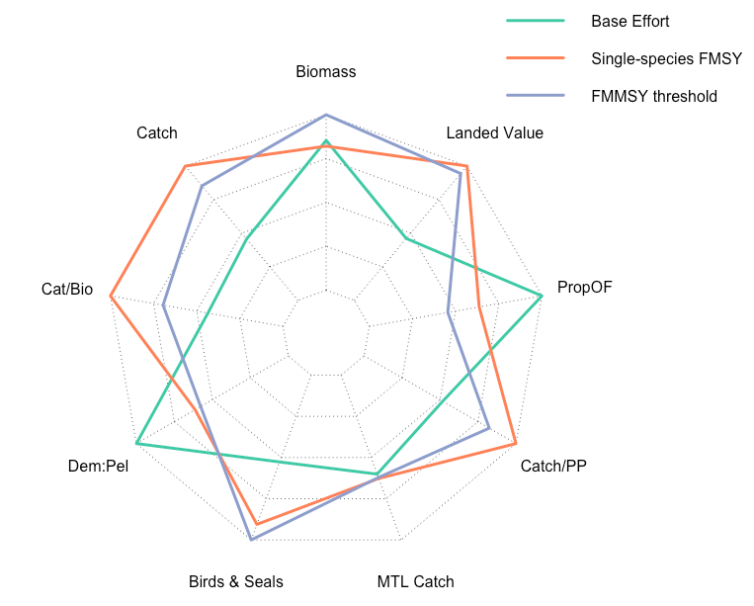
Fishing with threshold-based limit on exploitation ecological benefits with little economic cost
Fay et al. In Prep.

Slide 33
Radar graphs
Social Indicators of Fishing Community Vulnerability and Resilience
Jepson and Jepson (2013) NOAA Tech. Memo. NMFS-F/SPO-129

Slide 34
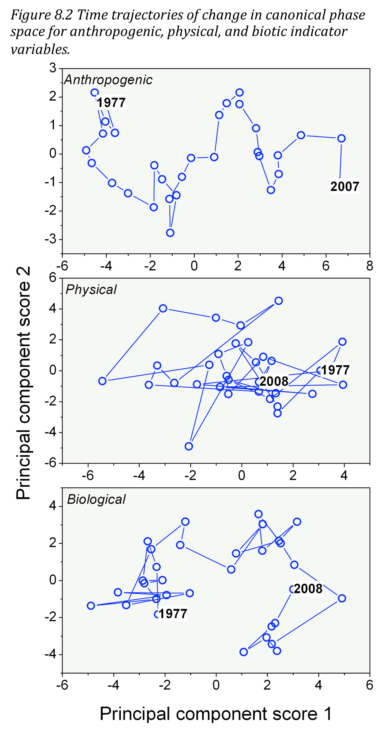
Multivariate Analyses
Principal Component Analysis, MDS, etc. can help to reduce dimensionality, and detect major systemic patterns.
Can provide indicator weighting to determine the major processes acting upon the overall system.
Also useful in a culling/vetting exercise.
http://www.nefsc.noaa.gov/publications/crd/crd1207/crd1207.pdf

Slide 35
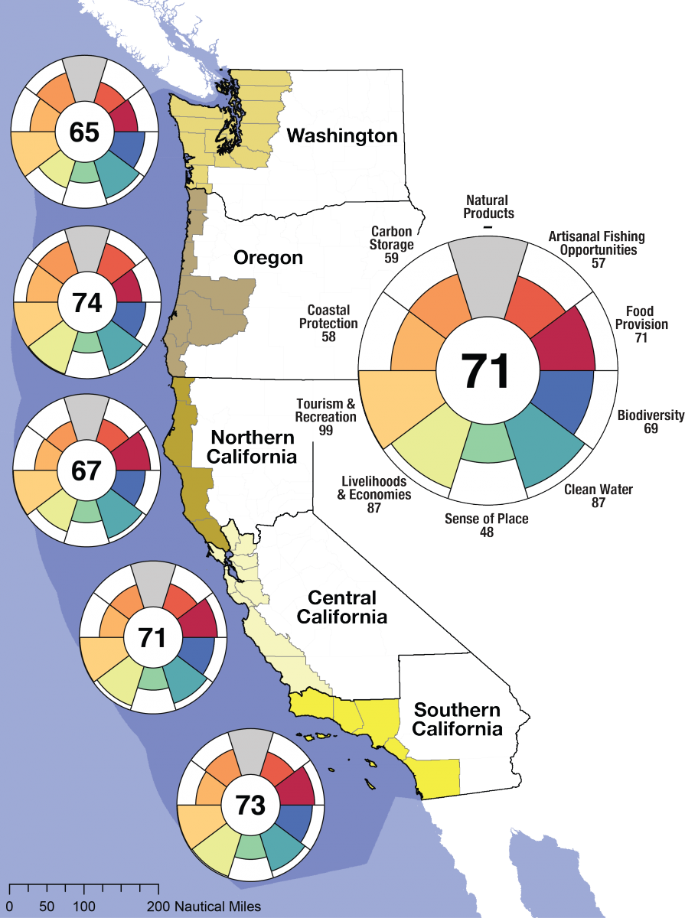
Composite Indicators
e.g., Ocean Health Index
Halpern et al. (2012)
Pros
Visually simple
Synthesize a LOT of information
Cons
Not necessarily transparent
Potential loss of information

Slide 36
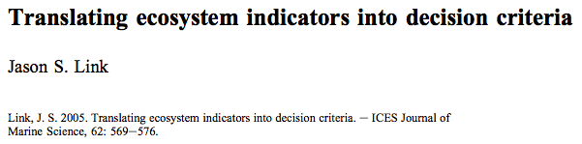
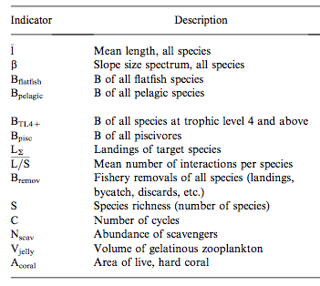
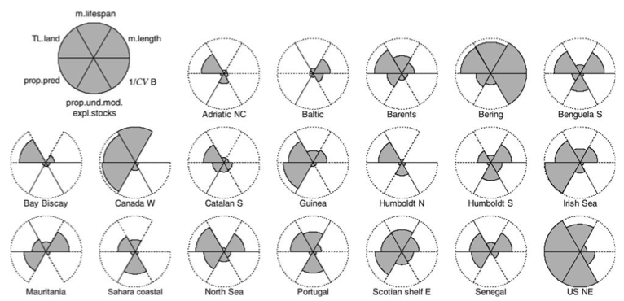
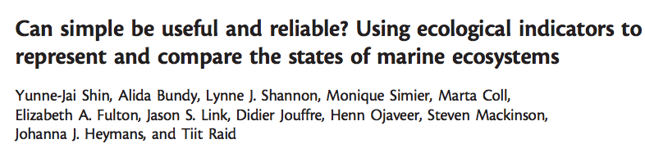
Using Indicators
Notes:
Analogous to traditional decision criteria
synthetic and quantifiable attributes that represent ecosystem status
translated into decision criteria for EBF to inform management action

Slide 37

2. Assessing Ecosystem Status
Multiple metrics
Biotic (resource and non resource)
Abiotic
Human
Long time series (?)
Modeling
Novel ways to package the information

Slide 38
3. Achieving Ecosystem Goals
Implementation
Tools for Action
What do we need?
Decision Theory
Reference Points
Control Rules for Action

Slide 39
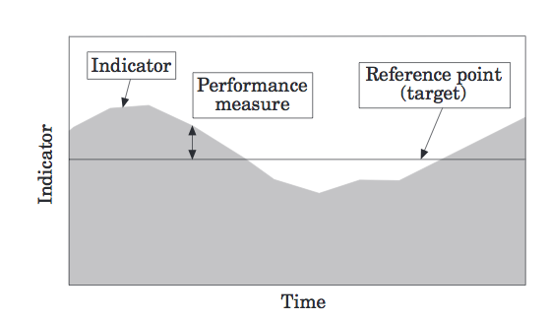
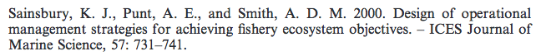
Monitoring ecosystem status relative to reference points: use indicators to stay ‘in bounds’

Slide 40

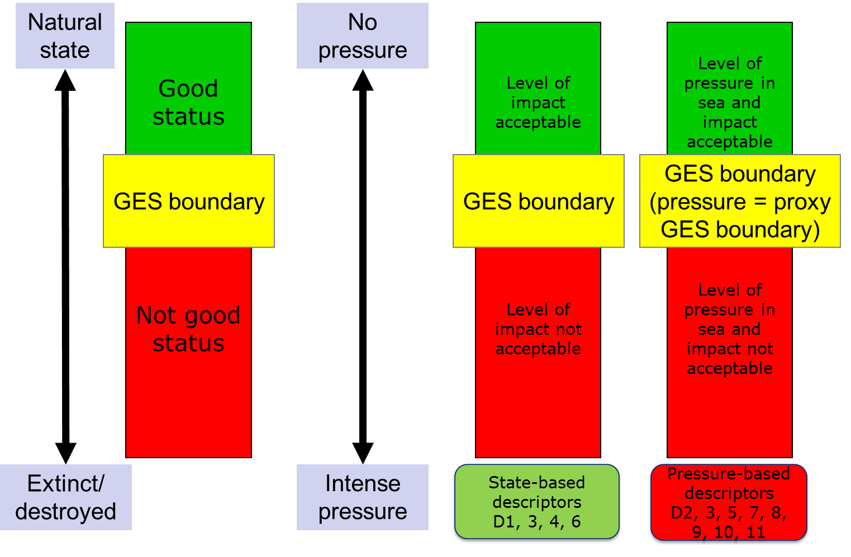
Reference levels.... and Good Environmental Status

Slide 41
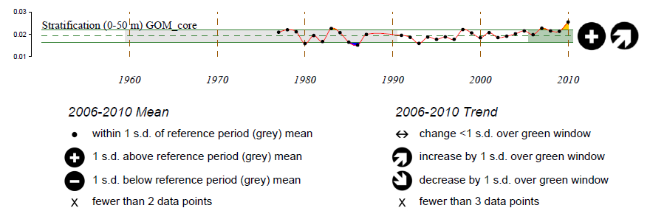
Indicators relative to reference periods
Often we don’t know what the ‘right’ value for an indicator should be.
Pressure-State relationships can be hard to identify.
Monitor change: have we seen this before?

Slide 42
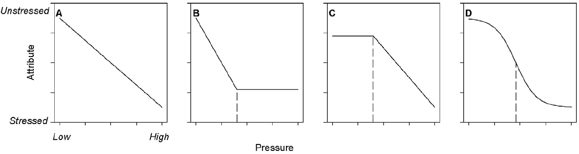
Translating indicators into decision criteria
Thresholds
Small change in pressure results in a large rate of change in ecosystem state or function
Separates management actions with large and desired effects from those with small effects
Steeper portion of the curve yields higher return on EBM investment
Samhouri et al. 2010 PLoS One

Slide 43
Decision Criteria: Aggregate Biomass
B_{TL4+}
< 25% B_{TL3}
OK
> 25% B_{TL3}
Threshold
> 50% B_{TL3}
Limit

Slide 44
Decision Criteria: Indicator Species
A_{coral}
A_{max}-(<Δ30)
OK
A_{max}-(Δ30+)
Threshold
A_{max}-(Δ50+)
Limit

Slide 45
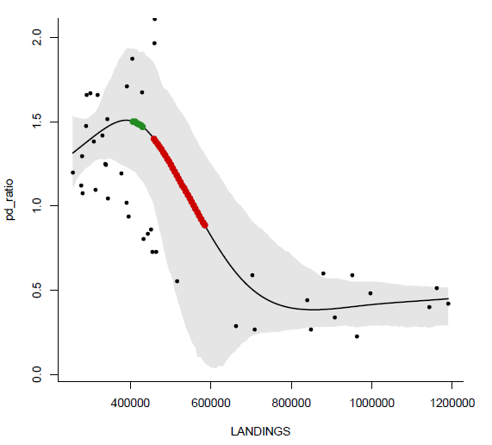
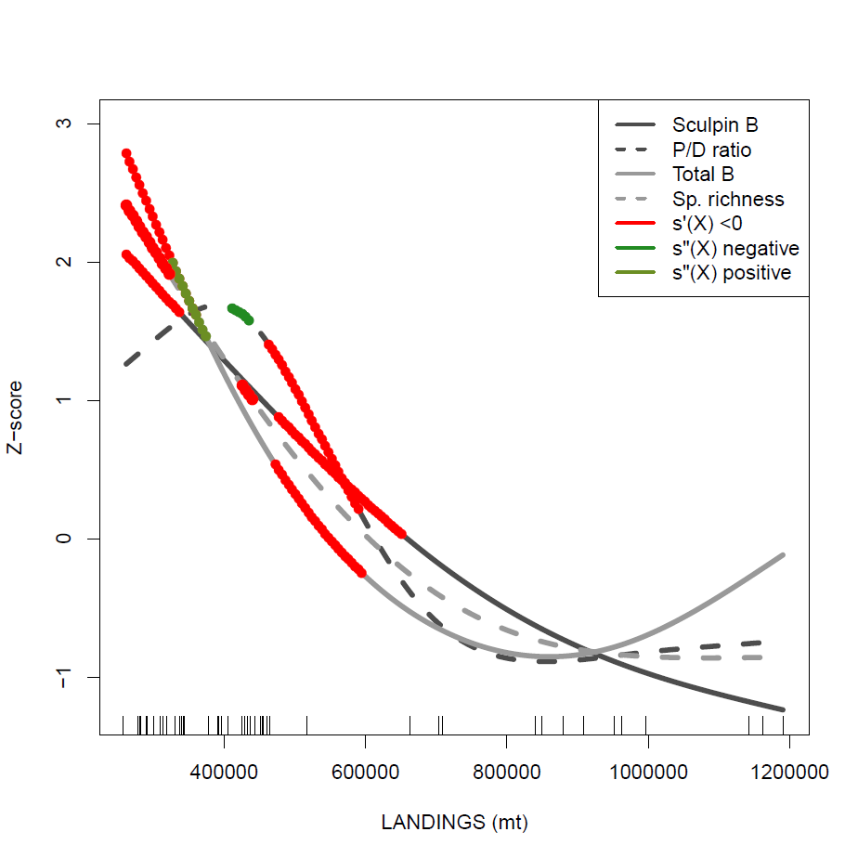
Empirical analysis of Indicator response using Northeast US trawl survey data
Thresholds in Indicators with respect to system drivers
Multiple indicators show change points at similar levels of landings
Large et al. 2013. ICES J. Mar. Sci. 70: 755-767.

Slide 46
Ecosystem Models can also be used to explore indicator response to pressures (fishing)
Fay et al. In Prep.

Slide 47
Translating indicators into decision criteria
Challenges
n - dimensional ecosystem space
Multitude of indicators that are important measures of ecosystem structure and function
n - dimensional societal space
Multitude of societal variables that are important to consider
n - dimensional pressure space
Multitude of pressure variables that influence ecosystem structure and function
How do we identify meaningful thresholds in multiple indicator’s response to multiple pressure variables?
Notes:
Idea of MV thresholds. Thresholds are all fine and good, but it’s probably a bit more complicated than we (like to) think.
Main Points:
Ecosystems are highly dimensional.
Shoot, adding humans makes it even more complicated!
Plus, there are multiple pressures concurrently influencing ecosystems

Slide 48
Decision criteria
Single Species
Model & empirical-based ref. points
Empirical and model-based control rules
Action to be taken shows direction and magnitude
Ecosystem
Model & empirical-based ref. points & directions
Arbitrary / empirical / model-based control rules?
Action to be taken may only show direction
Emphasizing integrated, systemic view
RP
CR
RP
CR(p)
CR(q)
RQ/RP

Slide 49
Using Indicator Derived Reference Points, Directions, Surfaces, Quadrats, AMOEBAS, etc.
What quadrat are we in (e.g., from PCA, or surface, or pole, etc.)?
What quadrat do we wish to be in?
Irrespective of mechanism, what factors produce the conditions in the desired quadrat?
Which of these can we control?
Can we then limit effort, landings, etc. for particular aggregate groupings to obtain the desired response? Or do we simply need to wait for a change in environmental conditions?
Assumes a reversible trajectory and causality among canonical axes.

Slide 50
Indicators and Decision Criteria
Empirical use of indicators as a function (or partial function) of a stressor (e.g. fishing) can help establish specified thresholds or limit reference points.
Development of empirically based indicator thresholds needs further work, but can be used NOW to establish some intermediate decision criteria.
Role of multivariate reference directions, surfaces, etc. merits further examination and application.

Slide 51
Extant and Feasible
Assessing the status of an ecosystem is not trivial, but is feasible.
Need multiple metrics to assess ecosystem status and develop system reference points.
Methods exist to establish and synthesize relationships and their relative importance among ecosystem processes.
We now know the status of many marine ecosystems (trends, magnitudes, and relationships) in a manner we have never known before.

Slide 52
Cautions when using indicators
Ecosystem Reference Points exist
Ecosystem level Management Indicators are currently difficult to implement
Indicators ≠ Reference Points
Reference Points ≠ Control Rules
Represents a key step towards operationalizing EBFM

Slide 53
What do we need?
INFORMATION:
Identification and vetting of key ecosystem indicators.
Commitment to data sources.
RESEARCH:
Evaluate indicator response to fishing (or other stressors) relative to other perturbations.
Commitment to modeling resources and development.
PROCESS:
More formalized decision analysis, MSE, and similar approaches to better use translated indicators.

Slide 54
Doing EBFM
Questions?

Slide 55
What’s Next?
Project outlines due 3/13
Major models used in fisheries
Extended single-species models
Multispecies models
Discussion on:
Collie et al. 2014
Hollowed 2000
Keyl & Wolff 2008
Whipple et al. 2000

